Slide 1
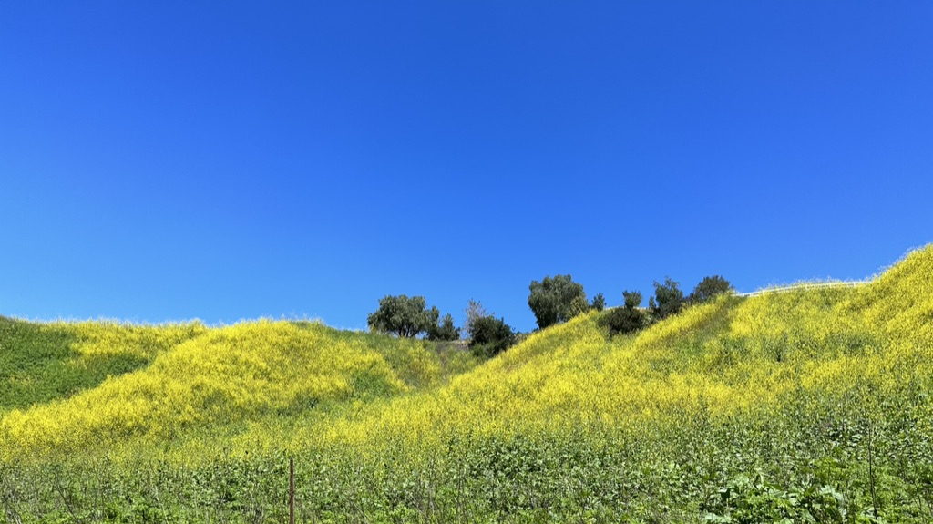
1 John Chapters 1-5
B R C
研讀聖經 跟從耶穌
NT #50 Bible Reading Class Pastor Warren Wang
Carbon Canyon

Slide 2
A Bible Reader’s Conviction
All Scripture is God-breathed and is useful for teaching, rebuking, correcting and training in righteousness, so that the servant of God may be thoroughly equipped for every good work. (2 Tim. 3:16-17, NIV)

Slide 3

A Blessed Journey
Read the Bible. Follow Jesus.
May you study God's Word with a reverent heart and walk in His will!
May the Word of the Lord prosper, and may the Lord add saved people to the church!
May the Lord bless your days of reading the Bible!
B R C
研讀聖經 跟從耶穌

Slide 4
The Guiding Principles of BRC
Christ-Centered
Bible-Based
Mission-Minded

Slide 5
BRC: A Gentleman’s Agreement
I’ll complete weekly reading assignment
I’ll watch weekly teaching video in its entirety
I’ll complete weekly quiz (closed book)

Slide 6
New Testament Structure
Synoptic Gospels (3)
John
4 Gospels
Acts
Paul's Epistles (13)
Other Epistles (9)
Historical Narratives (5 Books)
Doctrinal Explanations (22 Books)

Slide 7
1 John
Author The book itself does not state who the author is, but it is generally accepted that the author is the disciple of Jesus, John, for two reasons:
Church Tradition: Early Church Fathers (leaders of the early church) such as Irenaeus (140-203), Tertullian (155-222), and Origen (185-253) consistently pointed out that the author of this book is the Apostle John.
Similar Content: The content of this book bears many similarities to the Gospel of John.

Slide 8
1 John
Themes
Refuting Heresy: Where there is truth, there is heresy. The greatest heresy of that time was Gnosticism, which denied that Christ had come in the flesh (denying Christ's humanity). Many false teachers were promoting Gnosticism and deceiving many believers. The primary purpose of 1 John was to refute this heresy.
Proclaiming the Truth: While refuting heresy, the book also proclaims the truth. Most importantly, it affirms the status of Jesus Christ: He is the Son of God, the atoning sacrifice (propitiation) for the world, and he who has Him has eternal life.

Slide 9
1 John
Date of Writing
Between AD 85-95. It is generally believed that the Apostle John wrote this book between the Gospel of John (AD 85) and Revelation (AD 95).
Recipients
This is an open letter. In his old age, John lived in Ephesus (approx. AD 70-100). Ephesus was located in the province of Asia. Historical evidence suggests this letter was likely written to the various churches in Asia.
Features
On one hand, it emphasizes loving one another as the highest standard of Christian ethics.
On the other hand, it exalts Christ to refute heresy.
John repeatedly emphasizes "loving one another" and "exalting Christ." This repetition, resembling the "nagging" of an elderly person, is a characteristic of this book.

Slide 10
1 John
Outline
Prologue: The Assurance of the Incarnation (1:1-4)
Christian Life: Fellowship in the Lord (1:5-2:28)
Christian Life: Children of the Heavenly Father (2:29-4:6)
Christian Life: Christian Ethics (4:7-5:12)
Conclusion: Christian Assurance (5:13-21)

Slide 11
The "Happiness" of Being Nagged
There is a saying in my hometown: "An elder in the house is a treasure." Elderly people love their children and grandchildren deeply and have rich life experience, but they tend to be "nagging," often repeating what they consider important. Do not be annoyed; instead, feel blessed. When the elder is gone and no one nags you anymore, that feeling of being unanchored is very empty.
When John wrote this book, he was already an old man. He tells you to love one another in Chapter 2, again in Chapter 3, and yet again in Chapter 4. He says, "Dear children, fathers, young men," and then immediately repeats, "Dear children, fathers, young men" with almost identical content (2:12-14).
The Bible is God's word, but it also reflects the characteristics of its human authors. 1 John bears the characteristics of an elderly man.
Dear brothers and sisters, when you are being nagged, do not be annoyed; feel the happiness in it.

Slide 12
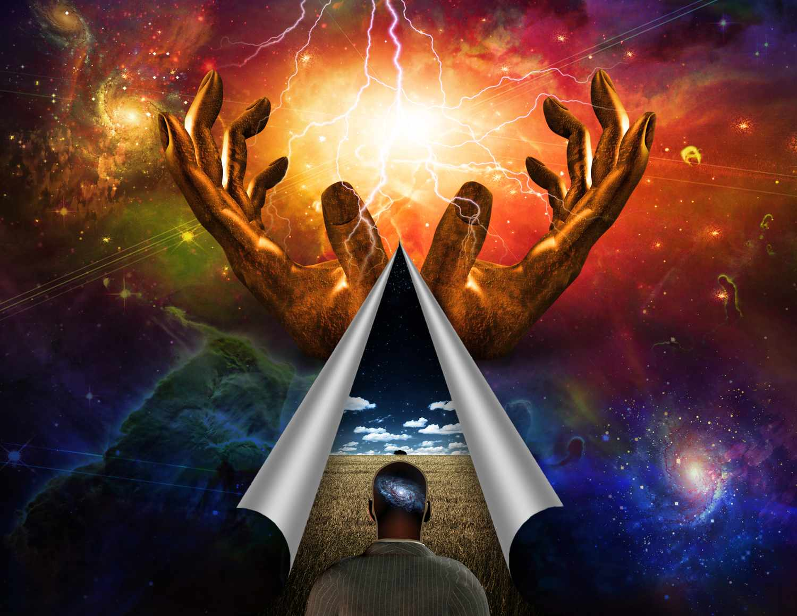
Understanding Gnosticism
Central Thought:
Dualism: The universe is divided into two parts: spirit and matter. Spirit is entirely good; matter is entirely evil.
Key Doctrines:
The human body is matter, so the body is evil. God is Spirit, so God is good.

Slide 13
Understanding Gnosticism
Key Doctrines
The body is like a prison that traps the human soul. If one wants to be saved, the soul must escape the body. How to escape? One must acquire special knowledge (gnosis in Greek, hence the name Gnosticism). Therefore, salvation does not rely on the redemption of Jesus Christ, but on the acquisition of special knowledge. Gnostic teachers claimed they could impart this saving knowledge.

Slide 14
Understanding Gnosticism
Key Doctrines
Regarding Jesus: Since the body is evil and Jesus is God, He could not possibly have a body. This led to two theories:
  Docetism (Phantom Theory): Jesus only seemed to have a body, but actually did not. What people saw was merely a phantom/illusion.
  Cerinthianism (Temporary Indwelling): The "Divine Christ" descended upon the "human Jesus" at baptism and left him before the crucifixion. The Divine Christ only temporarily had a body, but He was not crucified; it was the human Jesus who died on the cross.

Slide 15
Understanding Gnosticism
Key Doctrines
Ethical Extremes: Since the body is evil and unimportant, two extreme practices emerged:
  Asceticism: Since the body is evil, one must treat it harshly and make it suffer.
  Libertinism (Hedonism): Since the body is unimportant, one can do whatever they want with it, as long as the soul is saved.

Slide 16
Characteristics of Heresy
The characteristic of heresy is not the absence of Jesus, but "adding something as important as, or even more important than, Jesus."
Gnosticism claimed to believe in Jesus but altered Him into a "spirit-only, bodiless" Jesus and added something more important: Mystical Knowledge.
Legalists said they believed in Jesus but added Circumcision and Law-keeping as equally or more important.
Warning: If you claim to be a Christian, but your church, those around you, or you yourself have things that are "more important"—such as politics, religion, ideology, cultural traditions, theological stances, denominations, speaking in tongues, health and wealth, religious organizations, or religious figures—and you are more zealous for these things than for Jesus and His Gospel, then watch out. You know that you have deviated from Christ and are on a dangerous path. Turn back and return to Christ!

Slide 17

The Word of Life
The Word of Life 1 John begins with the "Word of Life," which is the Incarnate Jesus Christ. He has three characteristics:
He was from the beginning:
  Gnosticism argued that Jesus was a mere mortal who only became Christ when the divine spirit attached to him at baptism. 1 John refutes this, stating Jesus is the Word of Life who was with the Father from the beginning.
  "That which was from the beginning..."
  "The eternal life, which was with the Father and has appeared to us."

Slide 18
The Word of Life
He has a body (Tangible):
  Gnosticism claimed the body is evil, so Jesus was a phantom without substance. 1 John refutes this, stating Jesus was visible, audible, and tangible.
  "Which we have heard, which we have seen with our eyes, which we have looked at and our hands have touched."
  "We proclaim to you what we have seen and heard."

Slide 19
The Word of Life
He fellowships with people:
  Gnosticism believed Spirit is good and Body is evil, so Christ (Spirit) would not fellowship with mortals (flesh and blood). 1 John refutes this, saying the Father and His Son Jesus Christ do fellowship with us.
  "And our fellowship is with the Father and with his Son, Jesus Christ."

Slide 20

Fellowship Life
Definition of Fellowship: Koinonia: Common, Sharing
The definition of "Fellowship" is "living a common life."
"Fellowship with the Lord" means "living a common life with the Lord," which is what the Old Testament calls "walking with God."
"Believer Fellowship" must be built upon the foundation of fellowship with the Lord. The complete definition is "Living a common life based on a personal relationship with Jesus Christ."
Therefore, fellowship (koinonia) is not just a church activity or program; it is the exchange of life between believers, sharing of life, and living out Christ.

Slide 21
Fellowship Life
The Foundation of Fellowship
Just as a house needs a foundation, fellowship between believers needs a foundation. 1 John states that the foundation is every believer's relationship with the Lord: Each person first fellowships with the Lord, and then with people.
"We proclaim to you what we have seen and heard, so that you also may have fellowship with us. And our fellowship is with the Father and with his Son, Jesus Christ."

Slide 22

Walking in the Light
God-Centered Life: A Christian's life is God-centered, not man-centered, and certainly not self-centered. A Christian lives according to who God is; God's attributes determine the Christian's lifestyle.
God's Attribute: God is light; in him there is no darkness at all.

Slide 23
Walking in the Light
Result of Fellowship: Walking in the Light.
1 John uses two expressive words to describe fellowship with God: "Walk" and "Abide" (Stay/Live). "Walk" describes the dynamic aspect, "Abide" describes the static aspect.
"If we claim to have fellowship with him and yet walk in the darkness, we lie and do not live out the truth. But if we walk in the light, as he is in the light, we have fellowship with one another, and the blood of Jesus, his Son, purifies us from all sin."

Slide 24
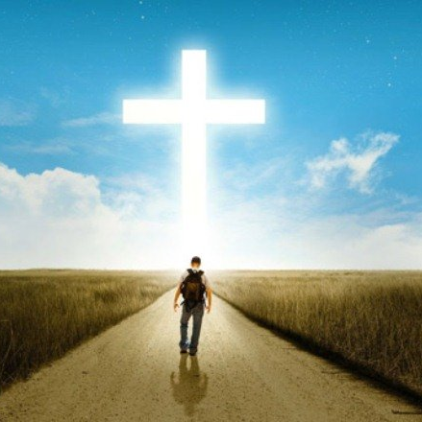
Life of the Children of Light
Five Features of Walking in the Light
1 John uses contrasts (Wisdom Literature style) to explain these features:
Confession vs. Non-Confession:
  If one fellowships with God, the light reveals stains, so they will inevitably admit they are a sinner. Conversely, if one does not fellowship with God, the darkness hides stains, so they will not admit sin. Confession brings forgiveness; non-confession results in no forgiveness.
  "If we claim to be without sin, we deceive ourselves and the truth is not in us. If we confess our sins, he is faithful and just and will forgive us our sins and purify us from all unrighteousness." (1:8-9)

Slide 25
Life of the Children of Light
Keeping the Word vs. Not Keeping:
  John is the Apostle of Love. Regarding what "Loving God" means, John is clearest: He says those who love God surely listen to His words, keep the Lord's commands, and live according to God's word.
  "We know that we have come to know him if we keep his commands. Whoever says, 'I know him,' but does not do what he commands is a liar, and the truth is not in that person." (2:3-4)

Slide 26
Life of the Children of Light
Loving Brothers vs. Hating Brothers:
  Am I walking in the light? The simplest way to answer is to ask yourself if you love your brothers and sisters. He who loves his brother walks in the light; he who hates his brother walks in darkness.
  "Anyone who claims to be in the light but hates a brother or sister is still in the darkness. Anyone who loves their brother and sister lives in the light, and there is nothing in them to make them stumble." (2:9-10)

Slide 27
Life of the Children of Light
Loving God vs. Loving the World:
  In the Bible, "the World" represents a sinful system opposed to God; its values are completely different from God's.
  "Love" represents the desire of the heart. What do you desire? Those who love God cannot love the world; those who love the world cannot love God.
  "Do not love the world or anything in the world. If anyone loves the world, love for the Father is not in them. For everything in the world—the lust of the flesh, the lust of the eyes, and the pride of life—comes not from the Father but from the world. The world and its desires pass away, but whoever does the will of God lives forever." (2:15-17)

Slide 28
Life of the Children of Light
Acknowledging Jesus vs. Denying Jesus:
  The most important feature of walking in the light is knowing Jesus according to the truth and acknowledging His status in one's life.
  "Who is the liar? It is whoever denies that Jesus is the Christ. Such a person is the antichrist—denying the Father and the Son. No one who denies the Son has the Father; whoever acknowledges the Son has the Father also." (2:22-23)

Slide 29
Antichrist
Big & Little Antichrists:
The Antichrist: A figure who will appear before Christ's return to oppose Him. Also called the Man of Lawlessness, the Beast. He claims to be God and deceives many.
Little antichrists: Before the appearance of The Antichrist, many who oppose Christ will appear first (like the Gnostics). They deny that Jesus Christ came in the flesh and tempt people away from God.
"Dear children, this is the last hour; and as you have heard that the antichrist is coming, even now many antichrists have come." (2:18)

Slide 30

Do Not Love the World
Do not love the world or anything in the world. If anyone loves the world, love for the Father is not in them. ¹⁶ For everything in the world—the lust of the flesh, the lust of the eyes, and the pride of life—comes not from the Father but from the world. ¹⁷ The world and its desires pass away, but whoever does the will of God lives forever. （2:15-17, NIV）

Slide 31

Lust of the Flesh, Lust of the Eyes, and the Pride of Life
Lust of the Flesh:
We have seen the lust of the flesh in Galatians: "So I say, walk by the Spirit, and you will not gratify the desires of the flesh. (Gal 5:16)" "The acts of the flesh" are defined very clearly: "The acts of the flesh are obvious: sexual immorality, impurity and debauchery; idolatry and witchcraft; hatred, discord, jealousy, fits of rage, selfish ambition, dissensions, factions and envy; drunkenness, orgies, and the like. (Gal 5:19-21)"
We see that when the Bible speaks of the lust of the flesh, the scope is not limited to sexual sins. Besides sexual immorality and debauchery, it also includes idolatry, witchcraft, hatred, discord, etc.
In the Bible, "flesh" refers to human sinful nature, and "lust" refers to insatiable desire. Things done to satisfy one's own sinful nature are all called the lust of the flesh.

Slide 32
Lust of the Flesh, Lust of the Eyes, and the Pride of Life
Warning:
Coveting another's spouse, extramarital affairs, and having a mistress are certainly the lust of the flesh; but factions, strife, hatred, and jealousy are also the lust of the flesh. You cannot say, "I only engage in factions and strife but do not commit adultery, so I do not have the lust of the flesh." No, you do. You cannot say, "I only crave vain glory but do not commit sexual sin, so I do not have the lust of the flesh." No, you do. You cannot say, "I only discriminate against others, but I love my family and my wife very much, so I do not have the lust of the flesh." No, you do. Any sin that comes from the sinful nature within, in whatever form it appears, is the lust of the flesh. You try to satisfy this lust, but you cannot, because "unsatisfiable" is its characteristic. Thus, you fall into a vicious cycle: last time a level of three satisfied you, this time you need four, and it goes on like this.

Slide 33
Lust of the Flesh, Lust of the Eyes, and the Pride of Life
2. Lust of the Eyes:
The first sin of mankind was related to the lust of the eyes: "When the woman saw that the fruit of the tree was good for food and pleasing to the eye... (Gen 3:6)" Thus, mankind disobeyed God's command, picked the forbidden fruit (the Bible doesn't say it was an apple), and ate it.
Lust of the flesh refers to desires originating from one's sinful nature, moving from the inside out; lust of the eyes, however, is sensory, moving from the outside in through what is heard and seen.
Beautiful things are attractive, but they are not necessarily beneficial to you. They stimulate your desires but rarely satisfy you. They make you obsess over them, causing you to relegate your relationship with God and with people to a secondary position.
If you see a shiny Ferrari, you obsess over it; if you see a beautiful LV bag in a shop window, you obsess over it. They please your eyes and make you want to possess them.
After obtaining them, you are still not satisfied and want to get even more and better things. At that point, these "good things" have become harmful things.

Slide 34
Lust of the Flesh, Lust of the Eyes, and the Pride of Life
Wisdom:
Allow me to quote ancient wisdom to further explain what the lust of the eyes is. Laozi said: "The five colors blind the eye, the five tones deafen the ear, the five flavors dull the palate; racing and hunting madden the mind; hard-to-get goods hinder conduct. Therefore the sage acts for the belly and not for the eye; he rejects that and takes this. (Tao Te Ching, Chapter 12)"
Five colors, five tones, five flavors, and hard-to-get goods are all beautiful things and very attractive, but no matter how much you obtain, it is difficult to be satisfied. A wise person "acts for the belly and not for the eye," seeking only to satisfy basic dietary needs, not pursuing the lust of the eyes.
John says "Do not love the world," and Paul says "But if we have food and clothing, we will be content. (1 Tim 6:8)" In this dazzling world where there are "so many good things," those contented Christians often live happier lives than others!

Slide 35
Lust of the Flesh, Lust of the Eyes, and the Pride of Life
Pride of Life:
Nathanael asked, "Can anything good come from Nazareth?" James and John's mother asked for high seats for her sons. The disciples argued over who was the greatest. Jesus said, "The Son of Man did not come to be served, but to serve."
Christian Taboo: Pride is the greatest taboo because the Lord is humble. Proud people cannot follow the Lord. Yet, proud Christians are everywhere, exalting themselves by worldly standards (race, wealth, status, education) and looking down on others.

Slide 36
Lust of the Flesh, Lust of the Eyes, and the Pride of Life
Some have been Christians all their lives, or even became ministers, yet they judge others by worldly standards. A pastor proudly declared from the pulpit: "My two daughters both married Americans, and they are white men." The audience let out a gasp of admiration. Why was the pastor proud? Why did the audience admire? Elder A, a PhD from University A, is over a decade older than Preacher B, a bachelor's graduate from University D. Elder A nitpicks Preacher B in every way, making life difficult for him. Preacher B swallowed his pride but finally could not bear it anymore and left in tears. Why do such things happen in the church? Frankly, the thinking of some Christians is extremely secular and deeply rooted. When Christians deviate from Christ and handle people and matters with a worldly perspective, all sorts of inconceivable things happen—and they happen in the church, commonly and frequently.
The Bible says: "God opposes the proud but shows favor to the humble. (James 4:6, 1 Peter 5:5)" There is good reason why John lists the pride of life alongside the lust of the flesh and the lust of the eyes.

Slide 37
Lust of the Flesh, Lust of the Eyes, and the Pride of Life
Church secularization is not a phenomenon unique to today; it has been so since ancient times. James rebuked the church for showing partiality based on outward appearance, inviting the rich man in fine clothes to sit in a high place while telling the poor man in filthy clothes to stand aside. Brothers and sisters, the existence of the problem is not the biggest issue; the biggest issue is that "the problem clearly exists, yet it is not treated as a problem."
The Bible constantly rebukes the pride and prejudice of the human heart, regarding this as a major issue. The situation today is that everyone has become numb to this phenomenon and does not think there is any problem. What comes out of the church is not the voice of rebuke, but speech and conduct that accommodate pride and prejudice.
On one side is the humble, self-sacrificing Lord; on the other is a church that tolerates pride, or is even proud itself. Can the two walk together? If the church only shouts slogans regarding doctrine and performs rituals, yet cannot walk with the Lord in actual life, can it still call itself the church of Jesus Christ?

Slide 38
The Anointing
"As for you, the anointing you received from him remains in you, and you do not need anyone to teach you. But as his anointing teaches you about all things and as that anointing is real, not counterfeit—just as it has taught you, remain in him." (2:27)
"Anointing" refers to the Holy Spirit. Jesus said, "When he, the Spirit of truth, comes, he will guide you into all the truth." (John 16:12).
The Spirit's purpose is not to make people speak in tongues or fall to the ground, but to guide believers into truth. The Spirit is the mentor who enables believers to distinguish true from false and identify antichrists, protecting them from false teachers.
Notes:
。

Slide 39
Characteristics of God's Children
Righteousness: "If you know that he is righteous, you know that everyone who does what is right has been born of him." (2:29)
Love: "Dear friends, let us love one another, for love comes from God. Everyone who loves has been born of God and knows God." (4:7)
Both are necessary. Righteousness without love, or love without righteousness, does not make a good child of God. As Micah 6:8 says: "Act justly, love mercy and walk humbly with your God."

Slide 40

God is Love
"Dear friends, let us love one another, for love comes from God. Everyone who loves has been born of God and knows God. Whoever does not love does not know God, because God is love. This is how God showed his love among us: He sent his one and only Son into the world that we might live through him. This is love: not that we loved God, but that he loved us and sent his Son as an atoning sacrifice for our sins. Dear friends, since God so loved us, we also ought to love one another. No one has ever seen God; but if we love one another, God lives in us and his love is made complete in us." (4:7-12)
This precious passage is the most concentrated and richest explanation of God's love in the entire Bible, conveying three important messages to us:

Slide 41
God is Love
1. What is God? God is love.
A. God's essence is love: It is like a piece of pure gold; no matter how you cut it or from which angle you view it, what you encounter is pure gold. God is love, He cannot deny Himself (2 Tim 2:13). No matter when you encounter Him, or how you encounter Him, He is love.
B. God is the source of love: Love comes from God. To walk with God is to walk with love; to connect with God is to connect with love. It is impossible to walk with God yet have no love in your heart. Nor is it possible to connect with God while loathing and hatred pour into your heart.
C. God's children possess love: How blessed are God's children! They connect to the fountain of love; God's love pours into their hearts, bringing them happiness, and they go out to love others, bringing happiness to others as well. The greatest characteristic of God's children is not their doctrine, church, rituals, or activities, but that they love one another.

Slide 42
God is Love
2. How did God demonstrate His love? God sent His one and only Son into the world to be the atoning sacrifice (propitiation) for our sins. This is how God showed His love among us!
If you want to find evidence of God's love for you, simply look up at the cross. Some people look for evidence of God's love in their daily lives, while others look for it during difficulties. "If God loves me, He will surely make my marriage proposal successful." "If God loves me, He will surely grant me success in my education and job search." "If God loves me, He will surely help me overcome difficulties, heal my illness, and turn danger into safety..." God watches over His children and provides for their daily needs, but those things are not the evidence. Whenever the Bible speaks of God's love, it always directs us to look at the cross. Only the cross is the evidence. Paul said: "But God demonstrates his own love for us in this: While we were still sinners, Christ died for us. (Rom 5:8)" John said: "This is how we know what love is: Jesus Christ laid down his life for us. (1 John 3:16)" The cross is the true evidence.

Slide 43
God is Love
3. We ought to love one another!
Father God is love, and His children are children of love. The Lord Jesus sacrificed Himself because He loved us, and His disciples are disciples of love. As Christians, we possess the dual identity of "children of God" and "disciples of the Lord"; therefore, we ought to, and indeed must, love one another. If we do not love one another, we are not God's children, not the Lord's disciples, and certainly not Christ's church.
Dear brothers and sisters, the greatest characteristic of the Christian faith lies not in theology, nor in culture, but in the divinity and humanity that are greater than theology and culture. Love is God's attribute, and it is also the deep longing of human nature. When we love one another, we exalt the cross of Jesus Christ, manifest God's attributes, and satisfy the deepest and greatest needs and longings of human nature.

Slide 44
God is Love
Reflections: Oh Old John, I love your nagging. Tell us again about God's love, tell us again about loving one another...
Reading 1 John is like listening to Old John nag. He says it back and forth, back and forth, endlessly: "Dear children, God is love, we must love one another. The Lord Jesus loves us and gave Himself up for us; we must love one another. This is the command the Lord gave us, that we love one another! See what great love the Father has lavished on us, that we should be called children of God! And that is what we are. Dear children, God is love, we must love one another. God's Son became the atoning sacrifice for our sins; this is love! There is no fear in love; perfect love drives out fear. Whoever loves God must also love his brother; this is the command we have from God. Dear children, you must love one another!"
Old John, I love Jesus, and I love your nagging too. Tell us again, nag us some more...

Slide 45

The testimony of water, blood and Spirit

Slide 46
The testimony of water, blood and Spirit
This is the one who came by water and blood—Jesus Christ. He did not come by water only, but by water and blood. And it is the Spirit who testifies, because the Spirit is the truth. For there are three that testify: the Spirit, the water and the blood; and the three are in agreement. We accept human testimony, but God’s testimony is greater because it is the testimony of God, which he has given about his Son. (5:6-9)
"Water" refers to Jesus' baptism, the beginning of Christ's ministry. "Blood" refers to Jesus' crucifixion, the completion of Christ's ministry. "Spirit" refers to the Holy Spirit testifying for the resurrected Jesus, the proclamation and continuation of Christ's ministry. These three are in agreement, all originate from God, and are God bearing witness for His Son. If we accept human testimony, we should all the more accept God's testimony.

Slide 47
The testimony of water, blood and Spirit
Due to the influence of the Gnostic heresy, some doubted that Jesus had a body, believing He was only spirit. Even if He had a body, it was temporary: the Divine Christ descended from heaven and attached to the mortal Jesus at his baptism; before the mortal Jesus was crucified, the Divine Christ left his body and ascended to heaven. To expound the true way and counter heresy, John repeatedly emphasizes in the book that Jesus Christ came in the flesh, having both spirit and body, and was heard with our own ears, seen with our own eyes, and touched with our own hands. From walking into the waters of the Jordan to be baptized, to being nailed to the cross, it was Jesus Christ Himself. After Christ's resurrection, the disciples, relying on the power given by the Holy Spirit, went to the ends of the earth to bear witness, and what they testified to was this Jesus Christ who came in the flesh, having both spirit and body. This testimony is actually God's own testimony for His Son. Jews believed that a testimony is valid only if given by two or three witnesses. God testifies for His Son through the three: "water, blood, and Spirit," and this testimony is true.

Slide 48
Assurance of Salvation
"And this is the testimony: God has given us eternal life, and this life is in his Son. Whoever has the Son has life; whoever does not have the Son of God does not have life." (5:11-12)
Satan's scheme is to make the most basic truths blurred and unclear. In the Christian faith, "salvation" is the most basic truth. Who is saved? How is one saved? If the answer to this question is wrong, the entire Christian faith is wrong. No matter how you serve or give offerings later, you cannot remedy this initial error.
John says in an unquestionable tone: "Whoever has the Son has life; whoever does not have the Son of God does not have life!" Brothers and sisters, the assurance of salvation is the Son of God, Jesus Christ. Having Jesus means having eternal life; not having Jesus means not having eternal life.

Slide 49
Assurance of Salvation
Some say: "I am saved because I have been baptized." Some say: "I am saved because I have taken Holy Communion." Some say: "I am saved because I attend worship services." Some say: "I am saved because I am a member of the church." There are even more preposterous reasons: because they have given offerings to the church, bought a Bible, their parents are Christians, or they attended Sunday school as a child... therefore they are saved.
Some people weep while listening to sermons, singing hymns, or hearing testimonies, and being moved, they say, "I want to believe in Jesus!" The church rejoices and thanks God that someone is saved, yet no one properly preaches the Gospel to them so that they may know Jesus Christ. "Faith comes from hearing the message" (Rom 10:17). If the Gospel is not preached clearly and not heard clearly, how can it produce a born-again, saved Christian? They have not believed in the Lord; they have merely believed in a religion.

Slide 50
Assurance of Salvation
Brothers and sisters, the key to the matter lies in the Son of God, Jesus Christ. Whoever has the Son of God has life (zoe); whoever does not have the Son of God does not have life. They do not have the Son of God because they have not heard of the Son of God; they have not heard of the Son of God because the Son of God was not preached.
They preach for a long time, but just don't preach Jesus. They talk about everything else: peace in the heart, spiritual sustenance, the church being loving, God hearing prayers, relying on Jesus to overcome difficulties, receiving God's abundant blessings, the wonderful anointing of the Holy Spirit, irresistible grace, and finally applying a formula, asking if you want to say a prayer of decision?
A person who becomes a "Christian" in this way does not have their foundation built on Jesus Christ, but on church rituals or other things. The result is that although they have believed in a religion, they have not believed in the Lord. They have no experience of being born again, nor the assurance of eternal life. What a pity!

Slide 51
Assurance of Salvation
Jesus said to the disciples: "Repentance for the forgiveness of sins will be preached in his name to all nations, beginning at Jerusalem. You are witnesses of these things." (Luke 24:46-47). The disciples faithfully testified for the resurrected Lord, preaching Jesus Christ and Him crucified, calling on people to repent and believe in the Lord, spreading the Gospel to all nations.
Brothers and sisters, the entire Christian faith is built upon the Son of God, Jesus Christ. Church ministry must be Christ-centered. Whether it is worship songs, pulpit messages, or more importantly the content of the Gospel, everything must be centered on Christ. It is not Calvinist theology, not the prosperity gospel, not speaking in tongues, not social services, and certainly not politics, but Jesus Christ.
Once such a church culture is established, where everyone from the pastor to the congregation preaches Jesus and glorifies Jesus, everything else will fall into place naturally. Those who come to your church will naturally hear Jesus, believe in Jesus, have the Son of God, and have eternal life.

Slide 52
Jesus Christ, Loving One Another
1 John revolves around two main themes as its axis: "Jesus Christ" and "Loving One Another," which appear alternately throughout the book. It speaks of Jesus Christ, then loving one another; then loving one another, and back to Jesus Christ. Jesus Christ is the faith; loving one another is the life. Regarding faith, Christians must believe in the Incarnate Jesus Christ, whom the Father witnessed to by "water, blood, and Spirit." Regarding life, we must circulate the love that comes from God and was revealed on the cross, by loving one another. Dear brothers and sisters, if you discover there is something in your faith more important than Jesus, you must be vigilant; you have believed wrongly. If you discover your love is decreasing and a heart of loathing and rejection is growing, you must be vigilant; you have believed wrongly. Turn back, turn back, return to Christ!
A central verse in the book serves as the summary of 1 John: "And this is his command: to believe in the name of his Son, Jesus Christ, and to love one another as he commanded us. (3:23)"

